Slide 1



Plant Disease Detection System
Submitted by:
Afreen Sudheer
STU6648529895c8e1716015768

Slide 2

Learning Objectives
The objective of this research is to create an automatic plant disease detection system based on deep learning methods, i.e., Convolutional Neural Networks (CNNs), to classify plant leaf images based on observable disease symptoms. Some of the key objectives are:-
Image database preparation and augmentation for improved model performance, multi-class classification model creation using TensorFlow and Keras
Model accuracy evaluation for identifying overfitting or underfitting.
The system is expected to help in early disease detection, lower reliance on human inspections, and enable scalable, real-time monitoring in agriculture.
It provides the basis for the application of computer vision in smart farming for enhanced crop management.
GOAL
Source
:
www.freepik.com/

Slide 3
Tools and Technology used
Several technologies, frameworks, and tools were employed in developing and training the plant disease detection system:
Programming language:
Python programming is used because it supports image processing and machine learning libraries.
Libraries and frameworks:
The CNN deep learning model is constructed and trained using TensorFlow/Keras.
OpenCV is utilized to carry out preprocessing and image operations.
Matplotlib is used to plot loss and training accuracy.
Pandas and NumPy are used for data manipulation and numerical calculations.
System:
Google Colab was used due to its cloud-based Jupyter environment, ease of use, and free GPU utilization.
Managing Datasets:
The ImageDataGenerator improves the robustness of the model using real-time data augmentation operations that include processes like rotation, scaling, and normalization.

Slide 4
Methodology
To ensure accurate classification outcomes, the project was done in a systematic manner:
Dataset Preparation:- Downloaded the dataset from a Google Drive ZIP file which contained over 63,000 images of healthy and infected leaves of 38 classes.
Preprocessing and Augmentation:- All the images were resized to 224×224 pixels. Pixel values were normalized to the [0,1] scale. Augmentation techniques like rotation were applied using ImageDataGenerator.
Model Architecture:- TensorFlow Keras API was used to create a Convolutional Neural Network (CNN). In multiclass classification, the network employs max-pooling, activation functions (ReLU), a number of convolutional layers, and fully connected layers with softmax.
Training and Validation:- 10% of the data was validated and 90% was trained upon. Backpropagation and optimization using the Adam optimizer were utilized while training. Epoch and batch size values were selected in order to provide a balance between performance and the speed of training.
Performance Monitoring: For learning trend monitoring, training and validation accuracy/loss were plotted. For robustness, class-wise performance was also tracked.

Slide 5
The Plant Disease Detection system employs a Convolutional Neural Network (CNN) trained using the TensorFlow-Keras framework. Input images are resized to a standard dimension of 224×224 pixels to ensure consistency and compatibility with the CNN architecture. The training data is augmented with random rotations up to 90° to increase variability and improve generalization.
Parameter | Value | Purpose | Reason for Value
batch_size | 164 | Number of samples per gradient update | Balances speed and GPU memory efficieny
target_size | (224,224) | Resizes images to fixed dimensions | Standard input size for CNNs
validation_split | 0.1 | Percentage of training data used for validation | Common value to monitor generalization
rescale | 1/255.0 | Mormalizes pixel values to [0,1] | Ensures faster and stable training
rotation_range | 90 | Augmentation: randomly rotates images | Introduces image variablity for robustness
shuffle | True | Shuffles the training data | Prevents model from learning data order

Slide 6
epochs | 5 | Maximum number of passes through the data | Allows sufficient training, terminated early if needed
early_stopping | patience=8 | Stops training if no improvement in val_loss for 5 epochs | Prevents overfitting, saved training time
steps_per_epoch | total_images//164 | Number of batches per epoch | Ensures full coverage of training data per epoch
validation_steps | val_images//164 | Number of batches for validation per epoch | Matches validation data size
optimizer | ‘Adam’ | Optimizes the wieghts during training | Adaptive, efficient for most tasks
loss | catgorical_crossentropy | Loss function for multiclass classification | Suitable for multiclass labeled data
metrics | [‘accuracy’] | Tracks model performace | Accuracy is intuitive and relevant for classification

Slide 7
Problem Statement:
Plant health is essential to agricultural production, and in the absence of disease detection in plants, there is a risk of disastrous losses in crop production. The traditional methods of detecting disease like manual checking:
Needs physical verification and access to technical expertise.
Is prone to human error, particularly in large-scale agricultural activities where continuous monitoring is difficult.
The proposed system will work to create a model based on Convolutional Neural Networks (CNNs) that will be capable of identifying and classifying crop diseases from leaf images of different crops. The model will be trained on a vast dataset of leaf images, including healthy and disease-infected leaves of different types of crops, for instance, apple, cherry, grape, etc.

Slide 8
Solution:
The suggested solution to the issue of sluggish and ineffective plant disease diagnosis is a deep learning algorithm on CNN that:
Identifies 38 pre-defined classes (diseased and healthy) from plant leaf input images.
Increases model robustness by mimicking various real-world conditions through real-time data augmentation during training.
With an accuracy of 89% in plant disease detection, the automatic system reduces crop loss and spreading of diseases and enhances agricultural production.
The below is the backend for the proposed system:
Source Code File: https://github.com/shajissa8/Week-3/blob/main/Plant_Disease_Detection_SystemC6_ipynb_txt.ipynb

Slide 9
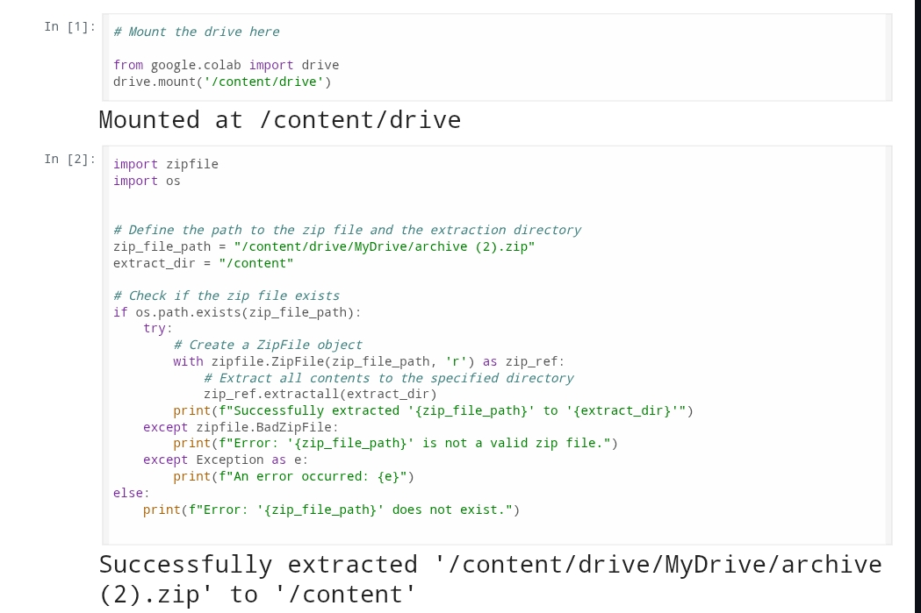
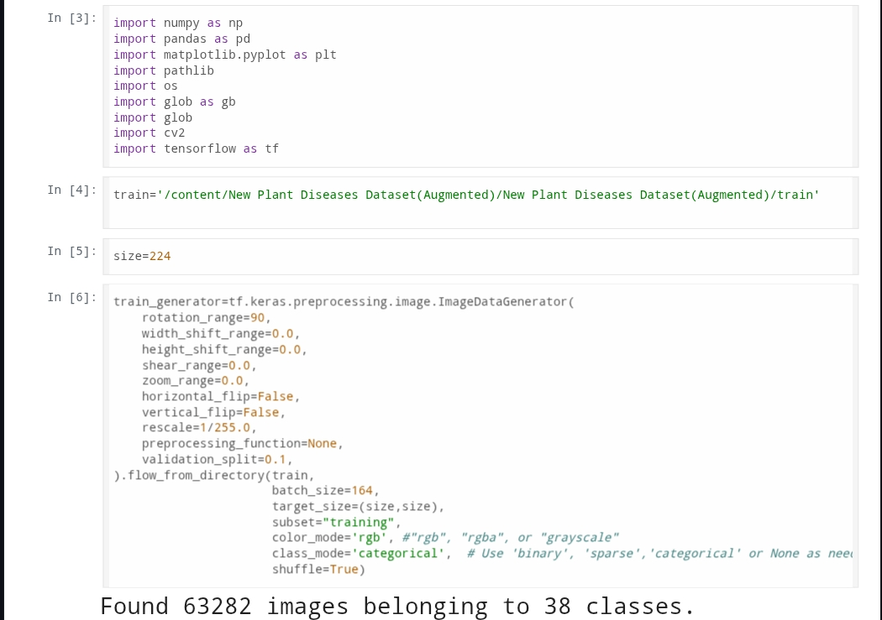
Screenshot of Output:
2.
1.

Slide 10
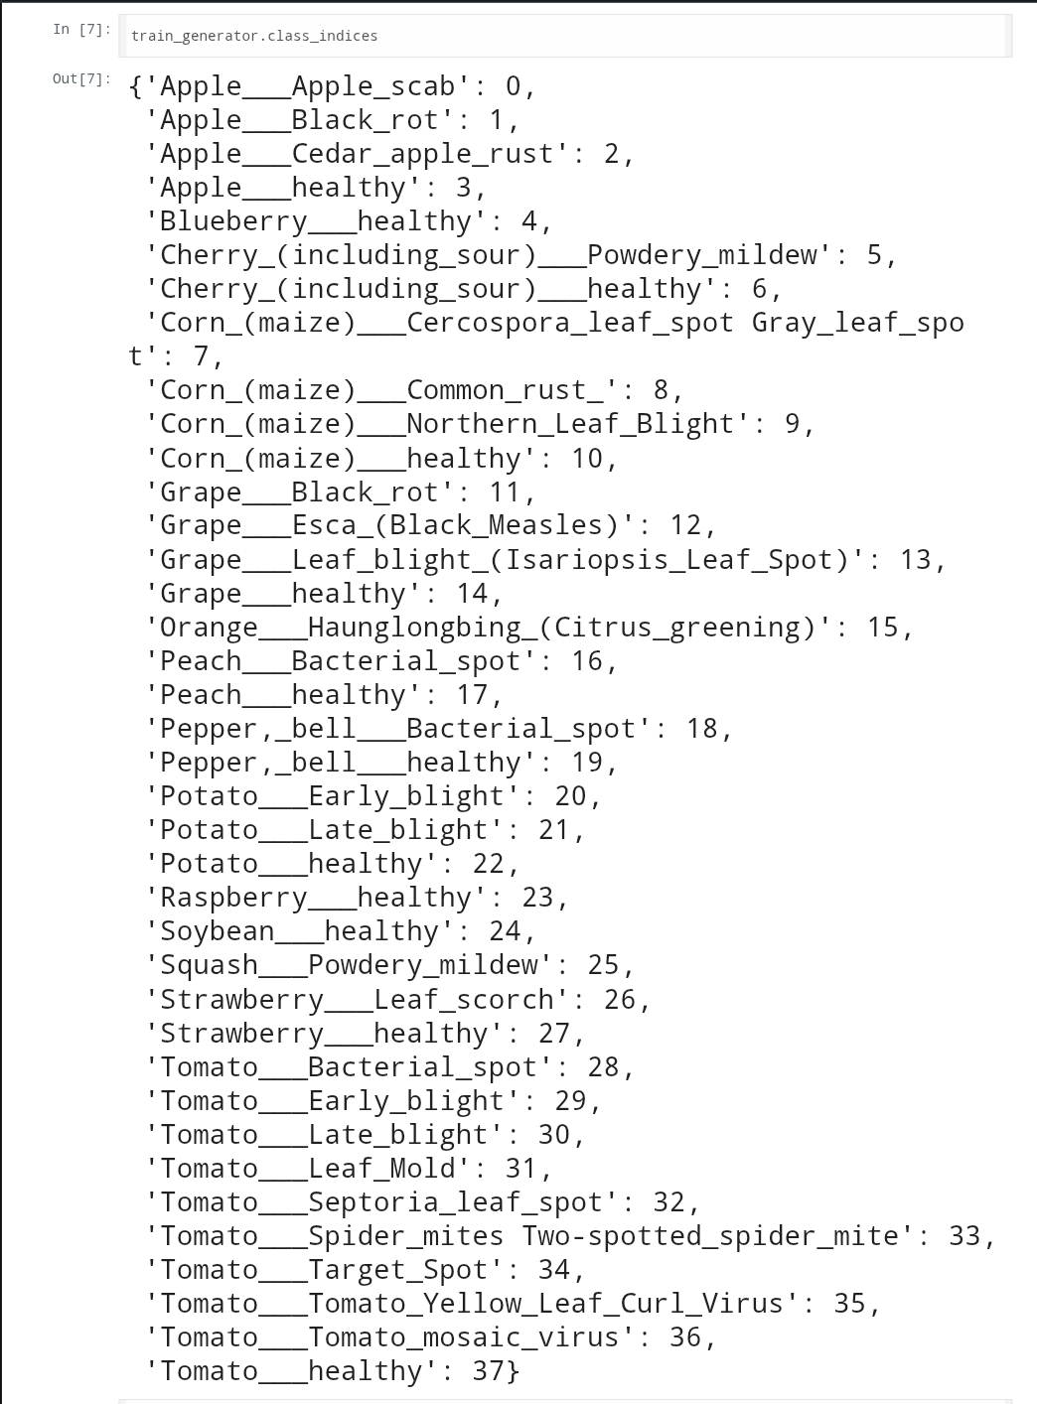
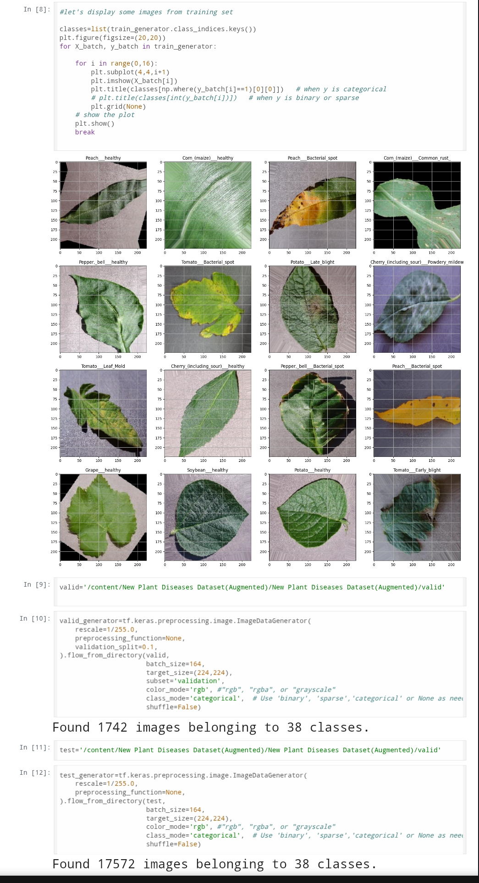
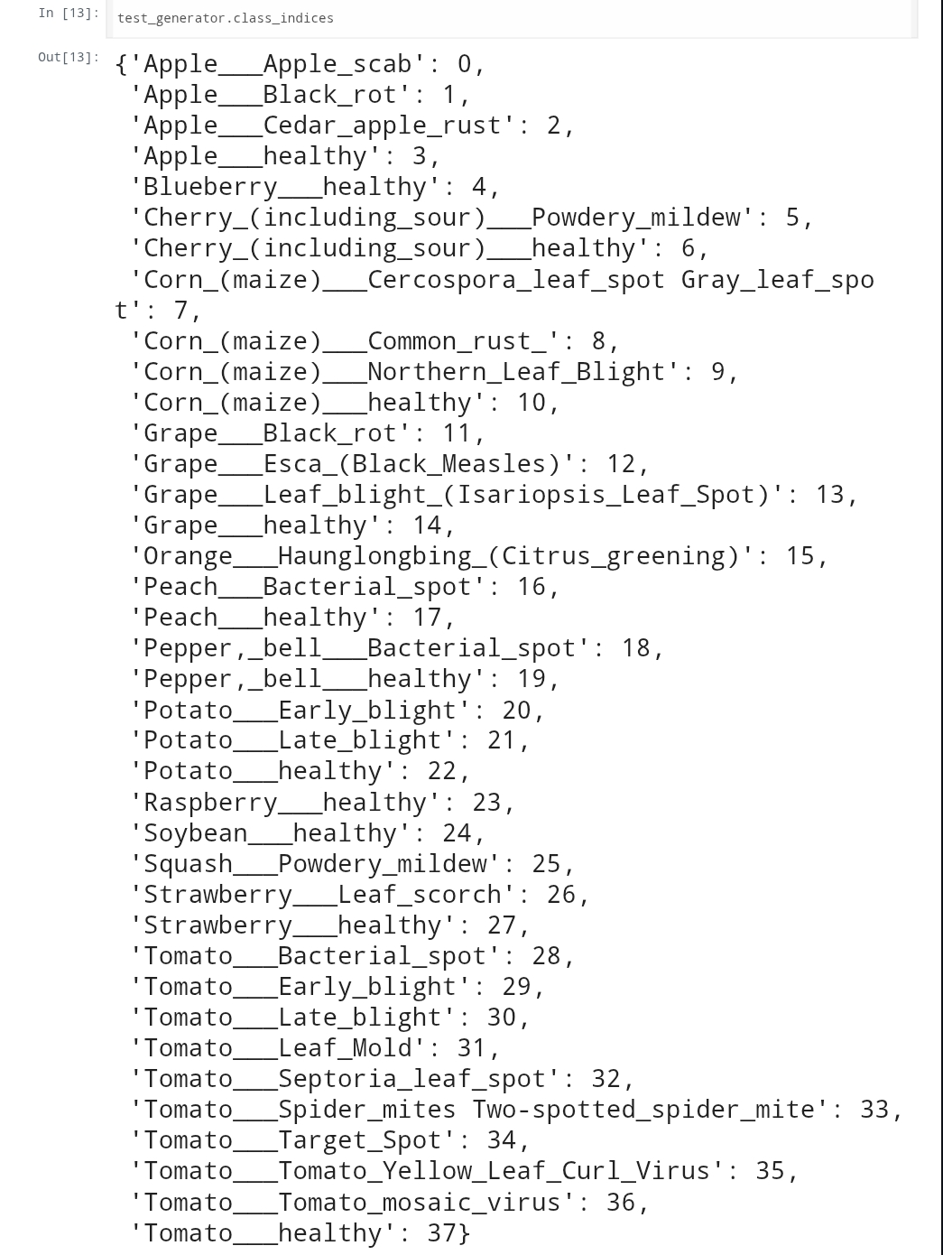
3.
4.
5.

Slide 11
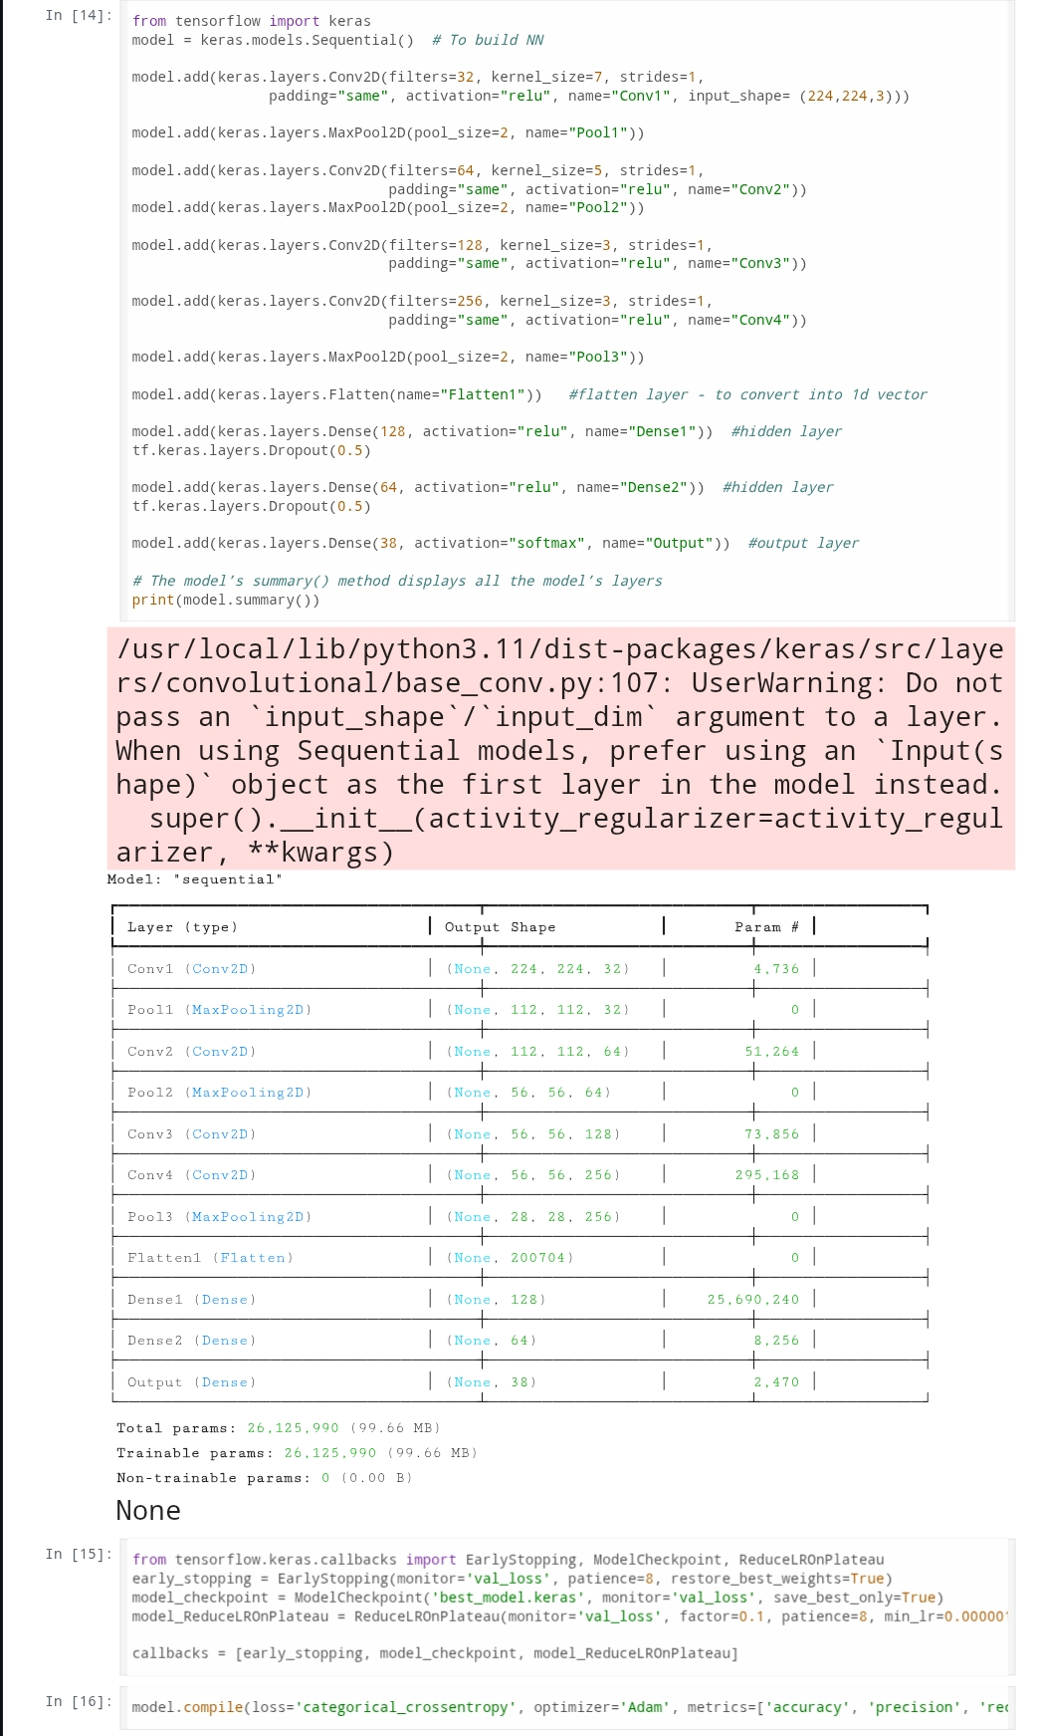
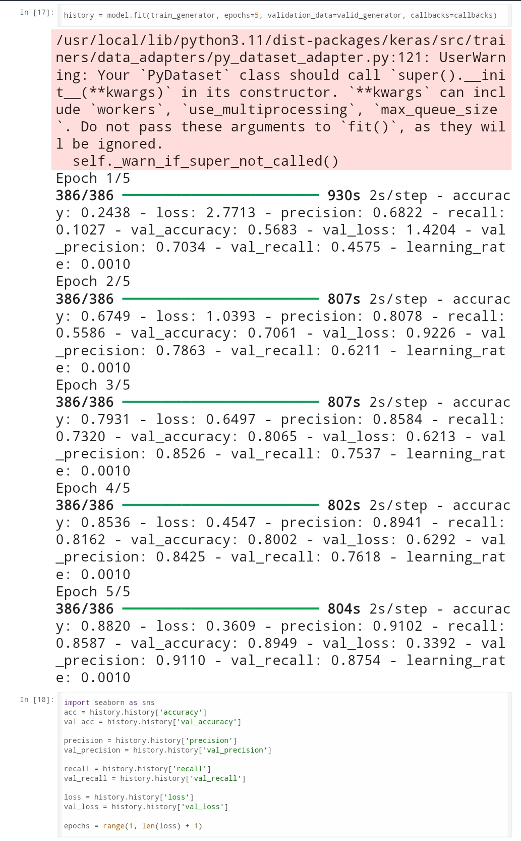
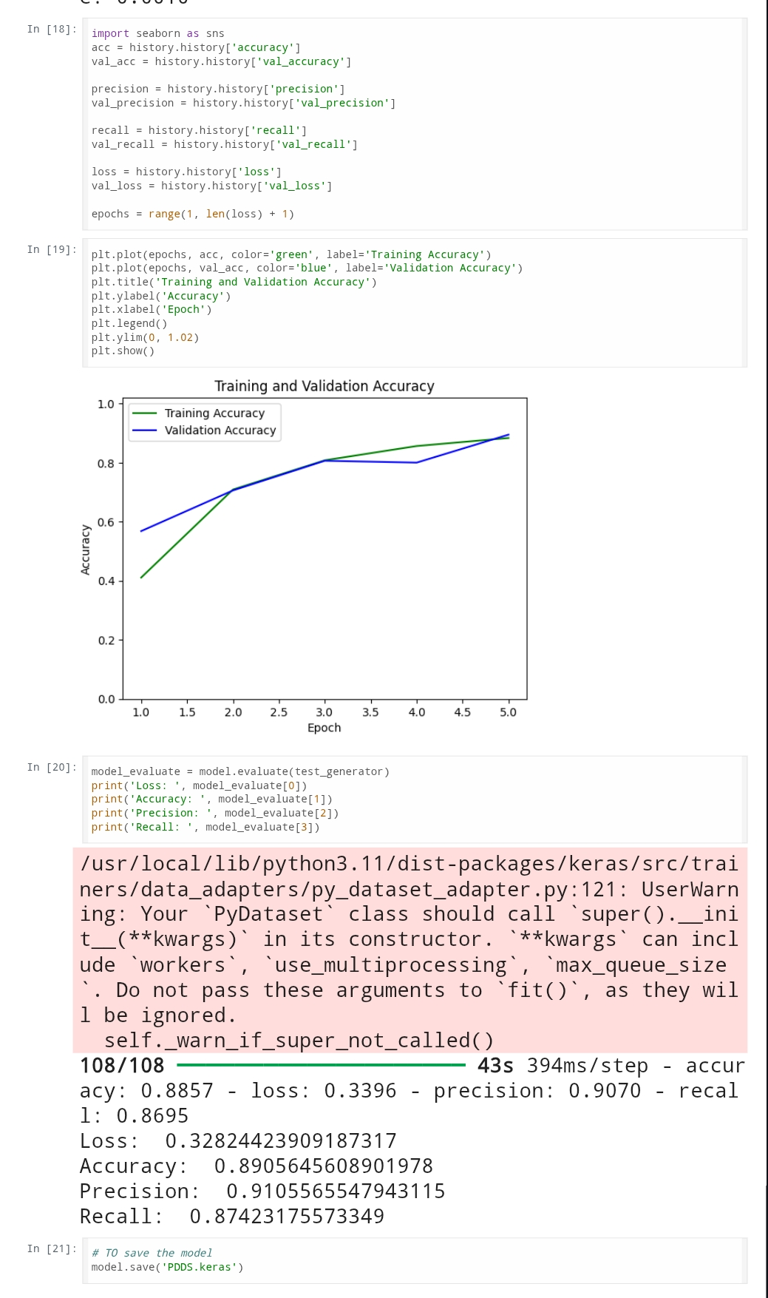
6.
7.
8.

Slide 12
Conclusion:
In this current study, a system based on deep learning was successfully developed for disease diagnosis and plant disease classification using image data. Convolutional Neural Networks (CNNs) proved to be effective in identifying diseases within 38 classes, with efficient training and validation results. With proper preprocessing of the dataset, augmentation techniques, and model fine-tuning, the system exhibited high capability for practical implementation in agriculture. The system holds the potential to help farmers with early disease detection, reducing dependence on expert analysis, and improving timely crop management.

